Slide 1

DEIB: The Business Imperative

Slide 2









Vision
Cultivate an enterprise-wide DEIB strategy, aligned with business objectives, that creates SYSTEMS and CULTURES of diversity, equity, inclusion and belonging, permeates every aspect of the business and empowers all employees and stakeholders, both internally and externally, to succeed.

Slide 3
The Why of DEIB - ROI
Increased revenues | Companies in top quartile for gender diversity 15% more likely to have financial returns above national industry median Companies in top quartile for racial/ethnic diversity 35% more likely to have financial returns above national industry median (McKinsey)
Increased diversity of thought and innovation, including better services and product offerings | Diverse management teams report 19% higher innovation revenue (BCG)
Increased market share | 45% more likely to realize growth in market share over previous year and 70% likelier to capture a new market (HBR)
Enhanced ability to attract, develop and retain talent | 76% of jobseekers indicate that a diverse workforce is an important factor when evaluating companies (Glassdoor) Enjoy 5.4 times higher employee retention (Great Place to Work)
Improved employee experience throughout the entire talent lifecycle. Employees bring their true, authentic selves to work, as well as embody a sense of community and belonging for all stakeholders | Employees 9.8 times more likely to look forward to going to work (Great Place to Work) 83% of LGB individuals, 79% of Black people, 67% women of color, 63% of Hispanic people, and 61% of Asian people “cover” or take great effort to hide/minimize some attribute(s) about themselves at work, with an average of 66% indicating that covering is somewhat to extremely detrimental to their sense of self (Deloitte)
Stakeholder value alignment and connectivity | When at least one member of a team has traits in common with the end user, the entire team better understands that user. A team with a member who shares a client’s ethnicity is 152% likelier than another team to understand that client (HBR)
Notes:
Gender diverse companies outperform industry norms by 15% & racially diverse companies by 35%
Diversity unlocks innovation and drives diverse market growth
Diverse management teams report 19% higher innovation revenue
diverse thoughts, experiences and perspectives in an environment that’s inclusive and creates equitable opportunities = more innovative ideas and solutions
Companies with leaders that have inherent (traits born with, gender/ethnicity/sexual orientation) and acquired diversity (traits you gain from experience, i.e. appreciating cultural differences by working in other companies) are 45% likelier to increase market share over previous year and 70% likelier to capture a new market
Attract & Retain Talent
A diverse workforce is an important factor for 76% jobseekers
When employees trust that they, and their colleagues, will be treated fairly regardless of race, gender, sexual orientation or age, they are:
5.4 times more likely to want to stay with their company &
9.8 times more likely to look forward to going to work
Fostering a culture of inclusion and belonging will improve the employee experience throughout the entire talent lifecycle so employees can bring their true, authentic selves to work
83% of LGBTQ+, 79% of Black, 67% of women of color, 63% of Hispanic/Latinos, 61% of Asian people “cover” (hide/minimize) some attributes about themselves at work
And 66% indicated that covering is somewhat or extremely detrimental to their sense of self
Connecting with our clients
A study shared by the Harvard Business Review found that when at least one member of a team has traits in common with the end user, the entire team better understands that user. A team with a member who shares a client’s ethnicity is 152% likelier than another team to understand that client

Slide 4
Advancing diversity, equity, inclusion and belonging enhances our ability to:
Deliver meaningful value to clients
Engage more clients and grow revenue
Develop and retain employees
Innovate and collaborate productively
Positively impact communities around the world
Establish a legacy to be proud of

Slide 5
Incorporating All Perspectives
The DEIB Advisory Board is the driving force behind our efforts to advance DEIB. With voices and perspectives from a cross-functional, cross-level representation of employees, this group elevates an environment where all employees feel welcomed, encouraged and valued. Member activities include:
Collaborating to advise and recommend DEIB policies, procedures and action plans
Helping to integrate DEIB strategies, initiatives and best practices that align with and advance NFP’s business objectives
Driving DEIB communications and serving as ambassadors across the organization and externally as we continue to engage, listen and evolve
Collaborating
Helping
Driving

Slide 6

Our DEIB strategy creates systems and cultures that permeate every aspect of the business and empower all employees and stakeholders, both internally and externally, to succeed.
Employee Pillar
Elevates diversity in our workforce through internal processes and opportunities that enhance efforts to attract, retain and grow talent, innovate and collaborate, and foster a sense of belonging for all.
Client Pillar
Enriches NFP’s client relationships by illustrating our DEIB practices, while developing offerings relevant to all organizations that have made DEIB a priority.
Internal
External
Community Pillar
Diversifies our charitable activities and involvement by engaging with and investing in programs that reflect historically underrepresented populations and align with NFP’s goals and values.
Supplier Pillar
Fosters and strengthens inclusive vendor relationships, examining internal processes and determining how to better diversify and enhance vendor partnerships.

Slide 7




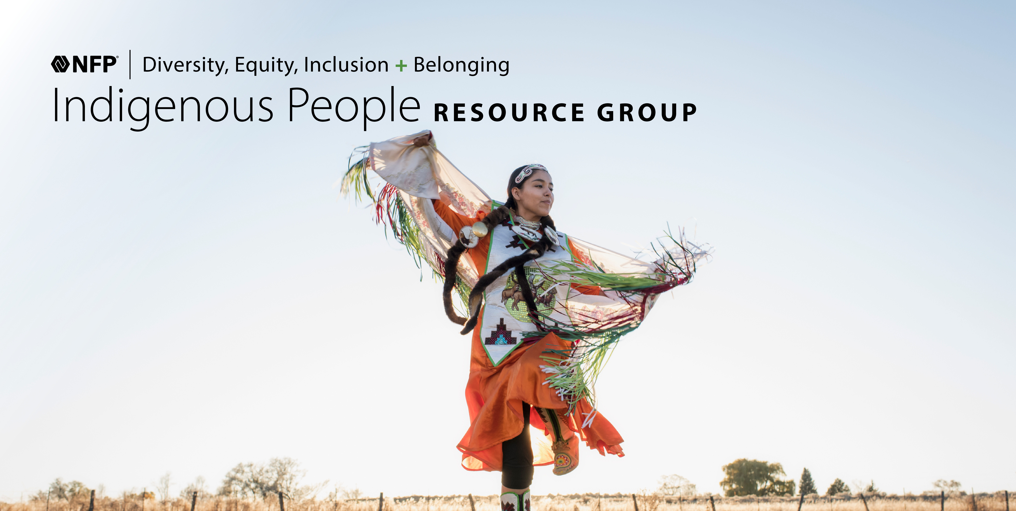




What is Innovation?
Employees are encouraged to engage, connect and get involved in our Business Resource Groups, collaborative and supportive forums where both members and their allies join with the community at large to ensure member development, enhance inclusivity and align with NFP’s business objectives.
Asian
Black Professionals
D-IS-Ability
Family
Indigenous People
Latine
Military & Veteran
Pride+
Women

Slide 8





On the Ground.
Our external engagement includes the following:
Industry Partnerships
Black Insurance Industry Collective (BIIC)
Canadian Association of Black Insurance Professionals (CABIP)
Financial Alliance for Racial Equity (FARE)
Insurance Supper Club
Link Canada (LGBTQ+ Insurance Network)
National African American Insurance Association (NAAIA)
The American College Center for Economic Empowerment and Equality
The American College of Financial Services
National or Global Partnerships
American Corporate Partners (ACP)
CEO Commission for Disability Employment
DisabilityIN
Diversity Woman Media
GenHERation
National LGBT Chamber of Commerce (NGLCC)
National Association of Asian American Professionals (NAAAP)
National Minority Supplier Development Council (MNSDC)
US Black Chambers
Wounded Warrior Project
Women's Business Enterprise National Council (WBENC)
Year Up
Regional Partnerships
100 Black Men of Austin
(a chapter of 100 Black Men of America)
Advisors Give Back
Envision
Indspire
Junior Achievement
Texas Empowerment Academy
Financial Alliance for Racial Equity

Slide 9




DEIB-Related Surveys & Indices
Paradigm for Parity
McKinsey/Lean-In Women in the Workplace
Best Places to Work in Insurance (Business Insurance)
HRC Corporate Equality Index
Work180
Insurance Business America's 5-Star Diversity, Equity, and Inclusion
Disability Equality Index
Seramount

Slide 10

C-Suite Engagement
Active participation at every level of the company is essential for long-term success.
Pamela Wheeler, our Chief Diversity and Inclusion Officer, spearheads our DEIB work, working with executives and leaders across the business to drive our progress.
Pamela Wheeler
Chief Diversity and Inclusion Officer

Slide 11
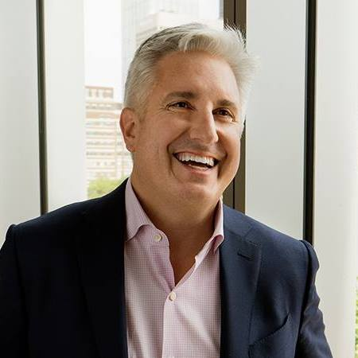
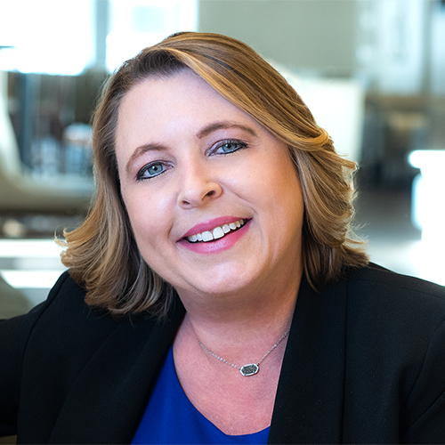
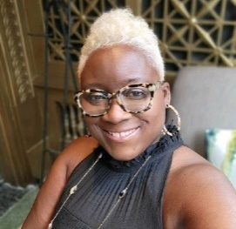
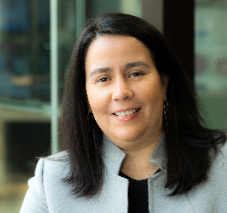
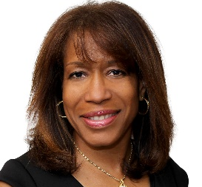

What is Innovation?
Key Leadership
Pamela Wheeler
Advisory Board Chair
Chief Diversity & Inclusion Officer
Doug Hammond
CEO and Chairman
Executive Sponsor
Mary Steed
Chief People Officer
Executive Sponsor
Kizmet T. Moore
DEIB Director
Ginnette Quesada-Kunkel
Chief Human Resources Officer
Executive Sponsor
Tandra Davis
SVP, Procurement
Executive Sponsor
Erin Vance
DEIB Director

Slide 12
“”
— Diversity requires commitment. Achieving superior performance diversity can produce further action – most notably, a commitment to develop a culture of inclusion. People do not just need to be different, they need to be fully involved and feel their voices are heard.
–Alain Dehaze (CEO of Adecco)

Slide 13


