Slide 1
Company
Overview
Personal Risk
Business Insurance
Group Benefits and Retirement
Life and Wealth
Helping companies and individuals address their most significant risk, workforce, wealth management and retirement challenges.

Slide 2
Company
Overview
Personal Risk
Business Insurance
Group Benefits and Retirement
Life and Wealth
Helping companies and individuals address their most significant risk, workforce, wealth management and retirement challenges.

Slide 3
Who We Are
NFP, an Aon company, is an integrated organization of consultative advisors and problem solvers.
We provide expertise to help companies and individuals address their most significant risk, workforce, wealth management and retirement challenges.
The value we deliver is driven by the proactive collaboration, diverse perspectives and grounded ambition of more than 7,700 colleagues in the US, Puerto Rico, Canada, UK and Ireland.
Our Mission
Deliver global capabilities and solutions to a diversity of clients, industries and communities by putting people first, prioritizing partnerships, solving problems and continuously advancing a culture we’re proud of.
Our Core Tenets
Put People First
Size and Scale Matter
Prioritize Partnerships
Solve Problems with Expertise
Build Culture with Integrity

Slide 4
Where We Are
NFP is a global organization, headquartered in the US, with a growing presence across Canada, the US, Puerto Rico and Europe.
Global
Reach
We have offices in
Canada, the US, Puerto Rico and Europe
7,700+
Global employees

Slide 5

NFP in Canada
13th largest global insurance broker
1,000+ employees
$1.0 billion+ in in-force
property and casualty premium
Over 20,000 corporate clients
$2.6 billion+ in qualified retirement assets
$500 million in in-force medical premium

Slide 6




















15 Years of NFP in Canada
2008 - 2013
2015
2017
2018
2019
2020
2021
2022
2023
40 Full-time Employees
(FTE)
+40 FTE
+187 FTE
+123 FTE
+360 FTE
+61 FTE
+135 FTE
+77 FTE
+70 FTE

Slide 7
Current Footprint
Regional Anchor Offices:
Ontario
  Toronto – Head office
  Ottawa
  Sudbury
  Windsor
Quebec
  Montreal
Western Canada
  Edmonton, AB
  Calgary, AB
  Langley, BC
YT
NT
NU
NL
BC
AB
SK
MB
QC
Edmonton
ON
P.E.I
NB
Langley
Calgary
Montreal
NS
Sudbury
Ottawa
Toronto
Windsor

Slide 8
Consistent Global Revenue Growth
2019
$1.46B
2020
$1.59B
2021
$1.91B
2022
$2.21B
2023
$2.50B

Slide 9

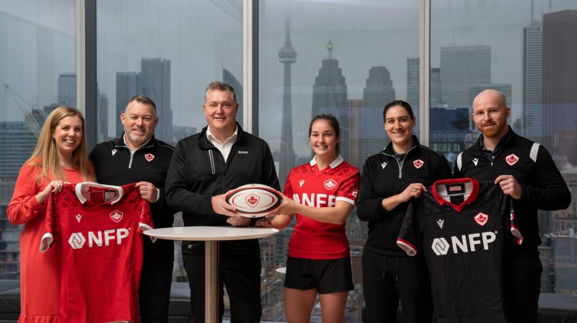





Community Investment
Official Insurance Partner of Rugby Canada
Official Team Partner of the Women’s 15s Senior Program
As an organization, we care about giving back to the community.
We contribute time and resources to local organizations, including Indspire, Women in Cancer Crusade and Food Banks Canada.
Let’s Play Rugby is the centerpiece of this multiyear signature partnership. The program will introduce rugby to more girls in the 13 to 16 age range who have a diversity of backgrounds and experiences, empowering self-esteem, leadership and teamwork in young people.

Slide 10

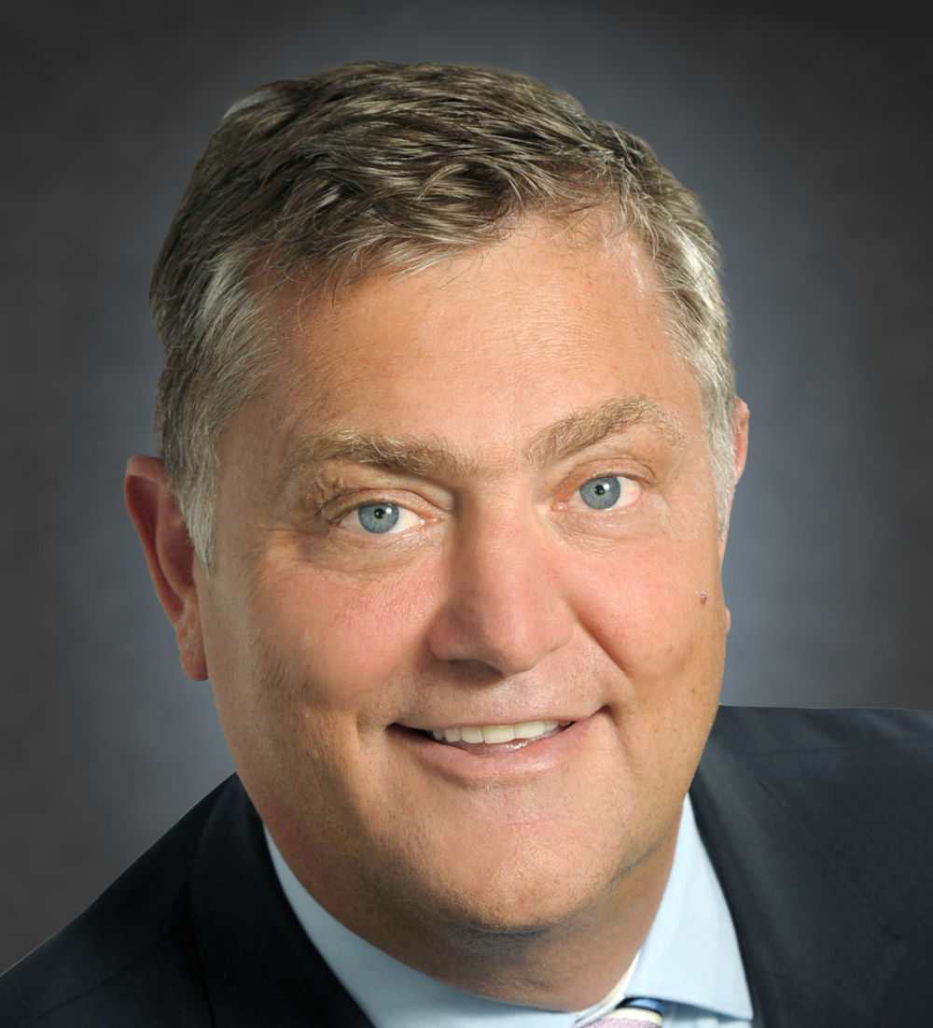
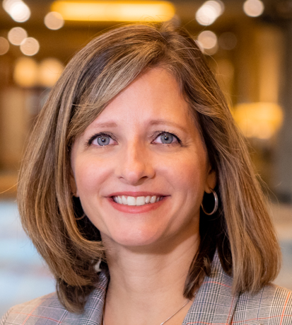
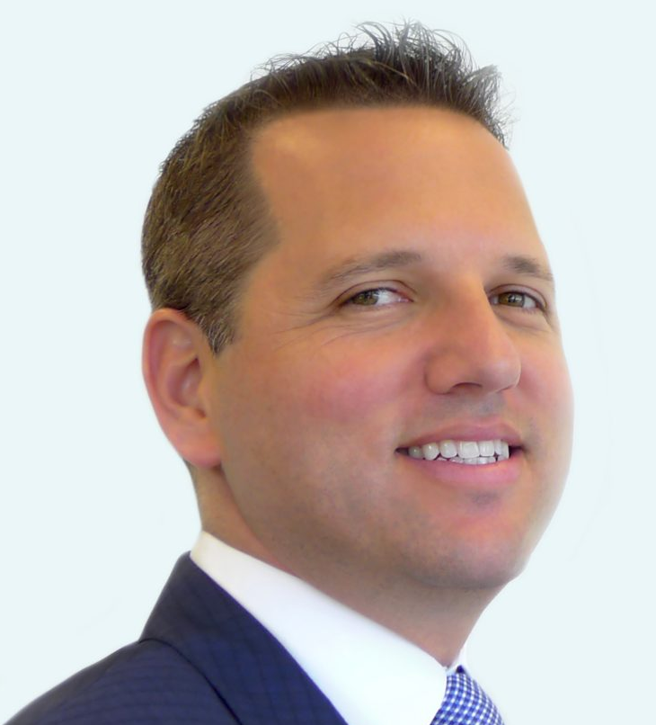
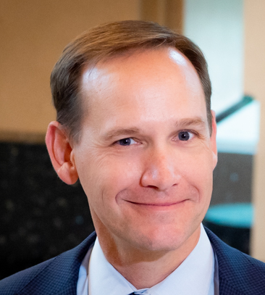
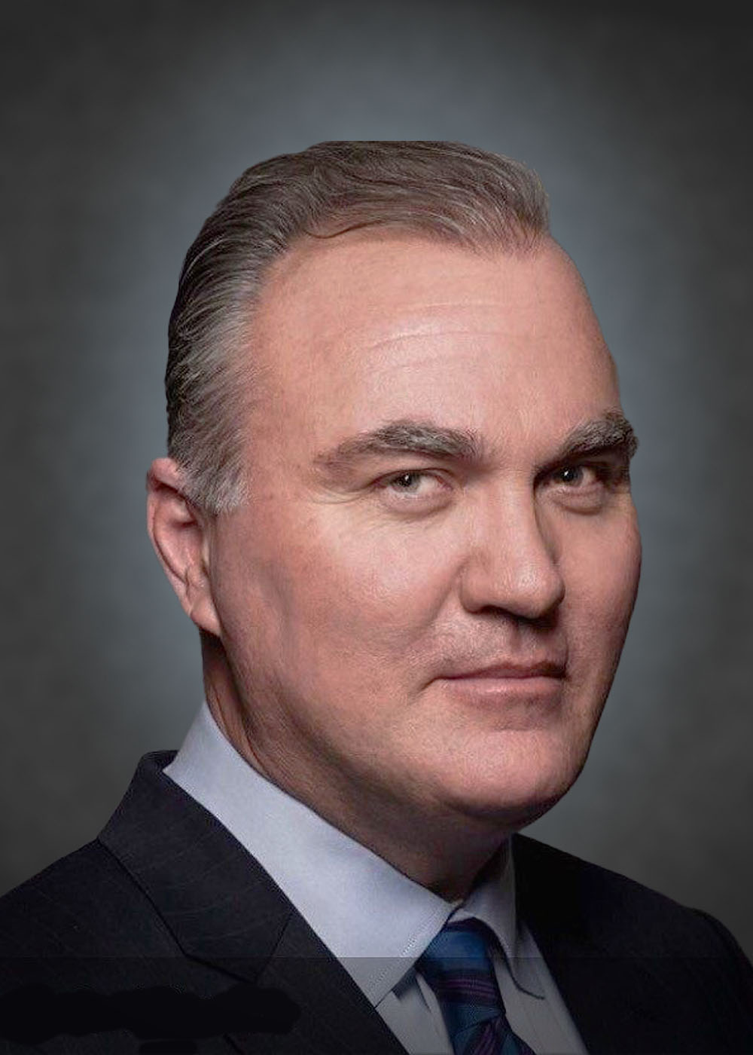
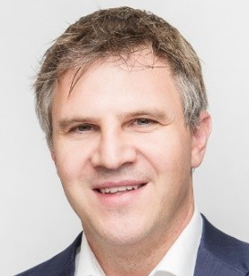
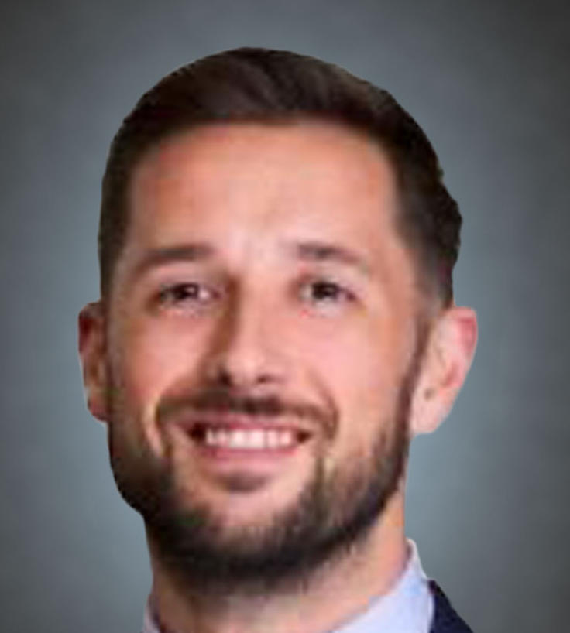
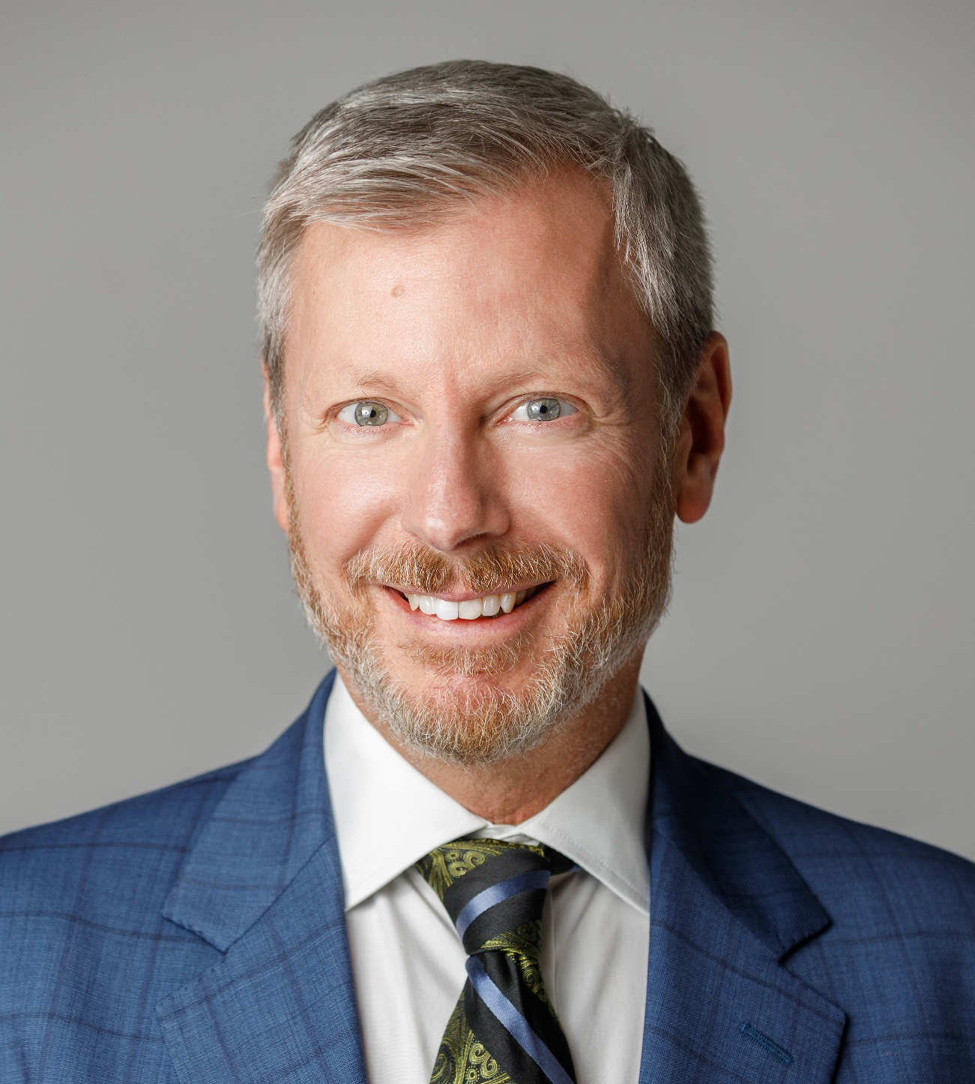

Canadian Business Line Leadership Team
John Haas
President
Sally Hagan
Managing Director, Group Benefits & Retirement
Mark Waxman
Managing Director, Life & Wealth Management
Greg Dunn
Managing Director,
Personal Risk
Scott Saddington
Managing Director,
Complex Risk and National P&C Strategy
Mark Wiens
Managing Director,
Commercial Lines
Evan Garner
Managing Director,
Complex Risk
Joe Seeger
Managing Director,
Complex Risk
Mike Werbowecki
Senior Vice President,
Retirement & Pension
Puja Patel
Vice President, Operations
Life & Wealth
Deb Hendrickson
Senior Vice President, Operations
Imran Pira
Senior Vice President,
Management & Professional Liability
Andre Charrois
Senior Vice President, Sales West
Sylvain Hamel
Senior Vice President, Complex Risk
Grant Smith
Senior Vice President, Complex Risk
Alecia Henderson
Senior Vice President,
Benefits
Adam Gurza
Advisor,
Life & Wealth
Julian Bugeja
Senior Vice President, Private Client Group
Rob Rasberry
Senior Vice President, Mid-Market
Sylvia Pockert
Senior Vice President, Complex Risk
Jocelyn Scherer
Vice President,
Complex Risk
Evelyn Kovolcik
Vice President,
Group Force Ontario
Pat O’Neill
Vice President,
Ontario Branch Offices
Guy Jolicoeur
Managing Director, Technical Risk
Lee Picher
Senior Vice President, Complex Risk
Katherine Dawal
Vice President,
Complex Risk
Nadia Quattrocchi
Vice President,
Group Force Quebec
Josh Pauls
Group PL Business Development
10

Slide 11
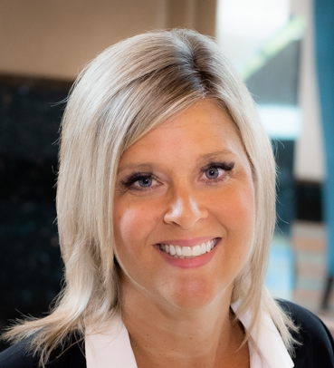
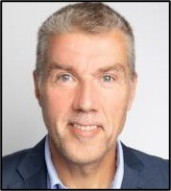
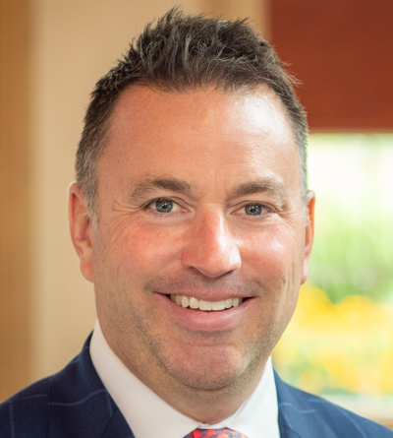
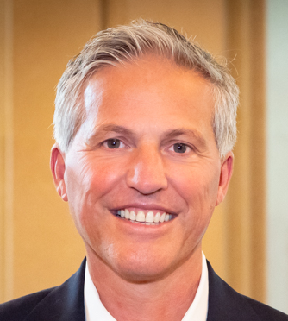
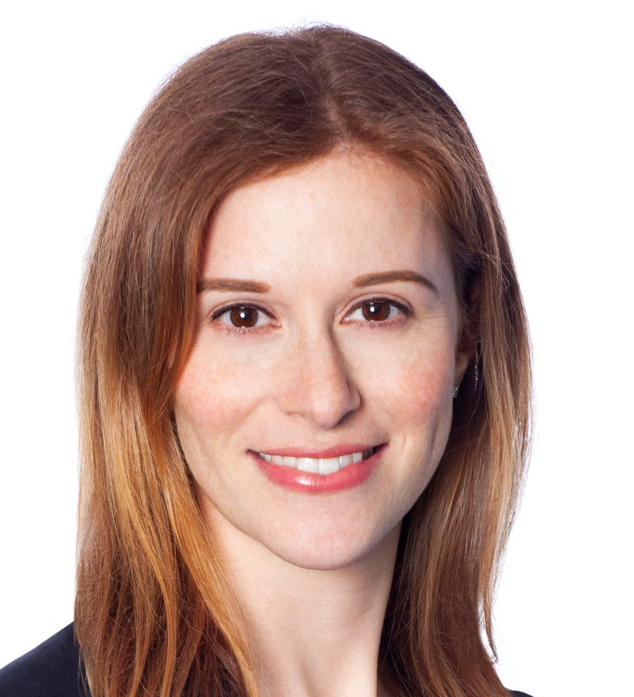
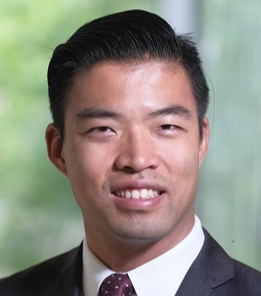
Canadian Corporate Support & Resources Team
Daryn McLean
Managing Director,
Strategic Growth
Greg Padovani
Senior Vice President, Mergers & Acquisitions
Lesley Munk
Senior Vice President,
Associate General Counsel
Owen Chung
Vice President,
M&A Integration Management
Tara Carruthers
Chief Financial
Officer
Terry Hearn
Senior Vice President,
Human Resources
Sandra Knifton
Senior Vice President
Benefits & Life
Ruby Kazmi
Human Resources
Business Partner
Pamela Derksen Deputy Chief Compliance Officer
John Hamilton
Senior Vice President
P&C
Carine Mapish
Human Resources
Business Partner
Jenna Grant
Vice President, Senior Legal Counsel
Amanda Tonks
Human Resources
Business Partner
11

Slide 12

NFP, an Aon company
Aon completed its acquisition of NFP on April 25, 2024, making NFP an independent and connected platform within Aon.
We operate independently under the NFP brand
We have access to the breadth and depth of Aon’s diverse resources and global reach
Client accounts/coverages and points of contact remain unchanged
We have enhanced our ability to help clients address their most significant risk, workforce, wealth management and retirement challenges
Aon is a complementary partner that supports our commitment to:
Providing specialized expertise and insight that drive better outcomes for clients
Advancing a people-first culture focused on well-being, belonging and impact
Driving growth organically and through strategic acquisitions
Investing in communities consistent with our values
Using our collective scale to create opportunities for employees and clients that align with their goals
  “Together, NFP and Aon will help clients address increasing volatility across risk and people issues. With high-performing teams and leading content and capability, we are creating more value for our clients while also enhancing long-term shareholder value creation for investors.”
  Greg Case, CEO, Aon

Slide 13
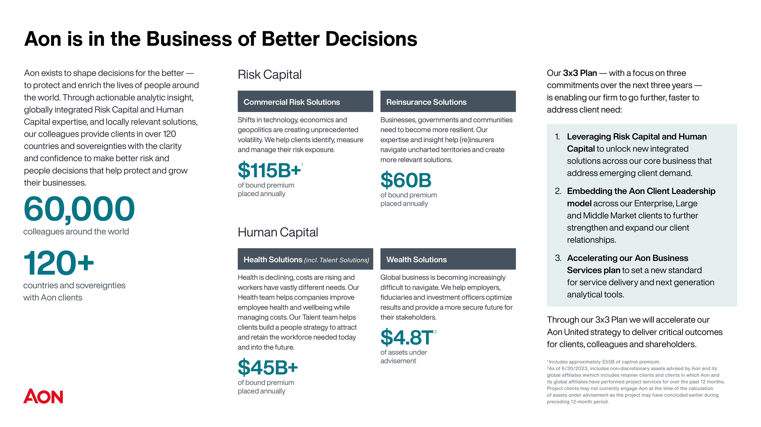

Slide 14
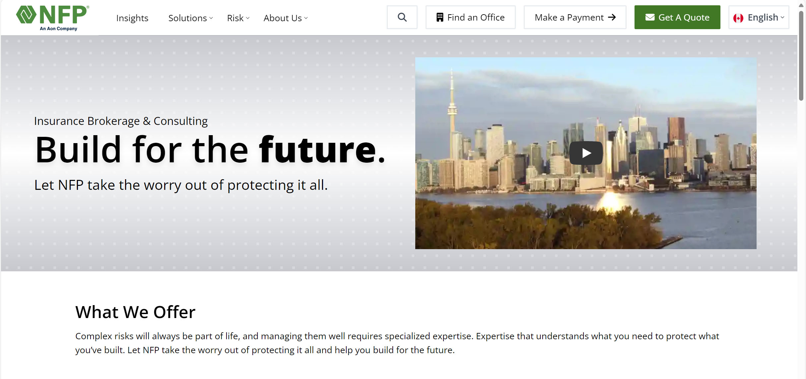
Communications
NFP.ca
A Window Into Our Company
NFP.ca is the best place to start finding solutions for your own and your business’s most significant risk, workforce, wealth management and retirement challenges.
Learn how we can help you plan for today and tomorrow. Explore the breadth and depth of our business, including the industries we serve. Our site also showcases our values and culture and provides an office locator so you can connect with an NFP expert.
We're constantly at work improving NFP.ca so you can quickly and easily find answers and insights.

Slide 15
Focus and Expertise
Personal Risk
Business Insurance
Benefits & Retirement
Life & Wealth
Car, Home, Motorcycle, RV
Farm & Equine
Group Excess Liability
Group Home & Auto
Individual Health Benefits
Mortgage Insurance
Pet Insurance
Private Client Group
Travel Health Insurance
Coverage Expertise
Custom Insurance Programs
Industry Expertise
Management & Professional Liability Services
Employee Benefits
Executive Benefit Plans
HR Solutions
Retirement Plan Advisory
Business Management Solutions
Wealth Management
Institutional Investment Committee
Life Insurance
Additional areas of focus – Innovation as well as Diversity, Equity, Inclusion and Belonging – are integrated throughout our business.

Slide 16
Personal Risk
Depth of EXPERTISE AND breadth of SOLUTIONS

Slide 17













Personal Risk
Home
Insurance
  Offering a breadth of solutions that are centered around our clients' needs
  Backed by knowledgeable and experienced, highly effective insurance specialists
  Providing access to markets with high limits and excess liability coverage and protection
Travel Insurance
Car
Insurance
DigitalShield
Group & Affinity
Home & Auto Programs
Pet
Insurance
Private Client Group Services
Unique
Property Risks
Motorcycle
Insurance
Equine Insurance & Hobby Farms
High Risk
Automobile
Leisure Vehicles: Boat, Trailer, Classic Car, Recreational

Slide 18
Personal Risk
  National offering providing expertise across three distinct customer value propositions
Private Client Group | Top Tier Clients 1:1 Client Relationship
Concierge Service | NFP VIP Clients & Emerging Wealth Small Dedicated Team
Regional Client Care Operations | Mainstream & Specialty Customers Dedicated Sales & Service Teams

Slide 19
Business Insurance
EXPERTISE AND SOLUTIONS

Slide 20

Business Insurance
Value Proposition
Building world-leading specialty businesses centers on our people — specialists who embrace our collaborative culture and have deep expertise across industries, products and programs.
These professionals drive success, differentiating our businesses and ensuring the delivery of expertise and solutions that help our clients manage their business more effectively.
We provide:
Specialist focus
Expertise
Technology leverage
Capital market access
Proven and consistent service model
Creative thinking

Slide 21

How We’re Different
Specialized expertise across industries and risk practices, informed by our deep understanding of clients’ specific goals and challenges
A boutique offering, supported by local service and insight, flexible access, customized solutions, and global resources, that aligns with client needs and drives an exceptional customer experience
Problem solving mindset that prioritizes listening and encourages creativity
Consultative approach that gets the right people in the room at the right time
Service agility, driven by empowerment and accountability, that enhances the client experience
Global capabilities to serve businesses and individuals no matter where they are
Collaborative, people-first culture focused on partnering with clients to enhance outcomes

Slide 22





National P&C Resources
Industry Verticals
Product Specialists
Construction
• Owners • Service Providers
• Developers • Suppliers
• Contractors • ISG Residential Construction
Environmental Liability
Natural Resources
• Forestry • Energy
• Mining • Powering Utilities • Oil and Gas
Management & Professional Liability
• Cyber Liability • Directors & Officers Liability
• Employment Practices Liability
• Fidelity & Crime Liability • Fiduciary Liability
• Errors & Omissions • Representations & Warranties Insurance
Agriculture
• Large Commercial Operations • Hobby Farms
• Confined Livestock • Grain and Cereal Operations
Trade Credit
Transportation
• Aviation • Rail
• Trucking • Marine • Auto Services
Contract and Commercial Surety
National Services
Loss Prevention • Claims Management • Analytics

Slide 23
National Services
Loss Prevention
Claims Management
Analytics
Actuarial services
Captives and alternative risk
Loss prevention
Claim submittal
Coverage analysis
Claims advocacy
Reserve and settlement evaluation
Claim reviews
Best-in-class technology
Benchmarking
Private data lake
AI-supported data enrichment
Customized and dynamic
claims data
Secure and private
document exchange
Digital content delivery
24/7/365 access
Propriety Loss Modeling

Slide 24
NFP Client Service Model
Prepare
Gather • Analyze • Develop
Perform
Evaluate • Service • Collaborate
NFP reviews every aspect of a client’s operation and identifies factors and plan solutions to mitigate risks that could seriously damage their company and reputation.
Through interviews with key individuals, site inspections, document analysis and market assessments, we translate complex challenges and key objectives to a tailored strategy.
NFP Placement Process
Promote
Negotiate • Compare • Recommend
Place
Execute • Review • Deliver

Slide 25
Group Benefits and Retirement
EXPERTISE AND SOLUTIONS

Slide 26

Group Benefits and Retirement
Value Proposition
Our Group Benefits and Retirement team comprises passionate and seasoned professionals dedicated to supporting each other and our clients.
We balance experience and savvy with agility and innovation to support our clients as they support their workforces.
We deliver the expertise, solutions and service that employers – of all sizes and across industries – need to attract and retain talent, support the diverse needs of employees and their families, and thrive.
Employee Benefits
Retirement
Actuarial Services – Pension Plan Funding and Accounting valuations, Post Retirement Life and Health valuations, flex plan pricing
NFP can provide a second opinion on your benefit and retirement programs at no cost or obligation to the client.

Slide 27


Our Employee Benefits Solutions
With a holistic, consultative approach to employee benefits, we start by assessing an employer’s unique goals and objectives, along with the expectations of their employees, and continue with the development and execution of a customized strategy designed to meet those specific needs.
Whether it’s a one-year or multi-year strategy, we’re there for our clients every step of the way with the breadth of solutions, depth of knowledge and excellence in execution that enhance outcomes.
Solutions and expertise include:
Employee benefits consulting
Benchmarking and trend analysis
Benefits compliance
Well-being and engagement
Employee communications
International benefits
Voluntary and ancillary benefits
Actuarial and financial analysis

Slide 28

An Integrated Approach to Client Care
Plan Design & Benchmarking
Partnering with you to design a benefits plan that aligns with your corporate and employee culture
Benchmarking your plan against your competitors’ plans
Provider Selection & Installation
Connecting you with a provider only after a comprehensive search based on your goals
Once you choose a provider, we’ll help introduce your program to employees.
Financial Review Analysis & Reconciliation
Reviewing your financing arrangements and comparing them against industry trends
Confirming billing rates and reconciling annual premiums, claims and financial results
Analyzing inflation and trend factors
Utilization Reporting and Analysis
Analyzing your plan’s financial performance and claiming patterns each quarter
Performing an in-depth analysis of drug utilization and disability claims
Review Analysis & Negotiation
Guiding you through the negotiation process
Providing cost containment recommendations
Negotiating renewal rates and executing upon your direction
Industry Updates & Account Support
Ensuring your program runs smoothly through continuous support
Updating you on the legislative environment
Assisting with billing/claims issues and employee education
.
*NFP does not provide legal advice.

Slide 29

A Retirement
Powerhouse
NFP is one of the largest retirement plan advisers in Canada, providing consulting services to more than 380 companies and overseeing nearly $2.6 billion in retirement plan assets
Our team focuses solely on areas that drive retirement plan success.
$2.6B
plan assets
380
companies
Investment analysis
Fee benchmarking and negotiations
Fiduciary compliance
Defined benefit administration and actuarial services
Governance best practices
Plan design
Participant education and financial wellness
Target date fund consulting

Slide 30
Life & Wealth
EXPERTISE AND SOLUTIONS

Slide 31

Life & Wealth Management Value Proposition
  We help individuals and families preserve, protect and grow their assets, as well as
  fund their personal, professional and philanthropic goals.
  Our expertise, market access, industry alliances and buying power are coordinated and delivered through our wholesale
  and retail life insurance and wealth management platforms.

Slide 32
Life Insurance Differentiators
Life Insurance
Estate Planning
Wealth transfer
Key person & partnership
Premium financing
Multigenerational planning
Asset protection
Permanent and term products
Underwriting advocacy and negotiation
Charitable planning
Annuities
Traditional fixed
Fixed indexed
Tax deferral
SPIA – single premium immediate annuity
Probate avoidance
Guaranteed income planning
Tax-efficient income distribution
Living Benefits
Individual disability insurance
Critical illness
Key person & partnership
High-limit disability insurance
Impaired/substandard disability insurance

Slide 33

Wealth Management Excellence
Investment management
Tax planning
Estate and succession planning
Family governance
Retirement planning and financial projections
Philanthropic advisory services
Family office-style services
Business owner advisory services
Advisor collaboration (lawyer, accountant, etc.)
Newport Private Wealth plays an integral role in the expansion of NFP’s wealth management offerings across Canada through a unique investment platform. Newport offers comprehensive wealth management services and a highly personalized experience for clients.

Slide 34
Diversity | Equity | Inclusion | Belonging
(DEIB)

Slide 35

The Power of DEIB
We want to be proud of the company we’re part of, so no matter how fast paced our environment is, doing things the right way is essential.
We’re all part of the same dynamic team, winning, learning and making an impact together, while appreciating the opportunities to collaborate on shared objectives.
Our diversity, equity, inclusion and belonging programs and practices are designed to support our employees, clients, supplier partners and the communities where we live and work.​
Collaborating
Helping
Driving

Slide 36


Active Participation at Every Level
The DEIB Advisory Board is the driving force behind our efforts to advance DEIB. With voices and perspectives from a cross-functional, cross-level representation of employees, this group elevates an environment where all employees feel welcomed, encouraged and valued.
Our regional action committees consistently deliver materials and resources to support employee learning and growth on a regional level, collaborating with business resource groups to cultivate engagement and implementation.
Business resource groups are employee-driven, serving as forums for advancement, alignment collaboration and belonging.
Led by example. Our DEIB principles are implemented at the C-suite level. Executives participate in the Lean In and McKinsey & Company “Women in the Workplace” study, and we work with Paradigm for Parity to keep moving toward a more equitable future.
Current Business Resource Groups:
Asian
Black Professionals​
D-IS-Ability
Indigenous People
Family
Latine
Military/Veterans
PRIDE+
Women’s

Slide 37
Cultivating DEIB in Community
We are committed to providing support for organizations with a vision for achieving critical DEIB progress in our industry and our communities.
Industry
National and Global
Regional
Black Insurance Industry Collective (BIIC)
Canadian Association of Black Insurance Professionals (CABIP)
Financial Alliance for Racial Equity (FARE)
LINK Canada (LGBTQ+ Insurance Network)
National African American Insurance Association (NAAIA)
The American College’s Center for Economic Empowerment and Equality
The American College of Financial Services
CEO Commission for Disability Employment
Disability:IN
Diversity Woman Media
GenHERation
National Association of Asian American Professionals (NAAAP)
National LGBT Chamber of Commerce (NGLCC)
National Minority Supplier Development Council (MNSDC)
US Black Chambers
Women’s Business Enterprise National Council (WBENC)
Wounded Warrior Project (WWP)
Year Up
100 Black Men of Austin (a chapter of 100 Black Men of America)
Advisors Give Back
Envision
Indspire
Junior Achievement
Texas Empowerment Academy

Slide 38

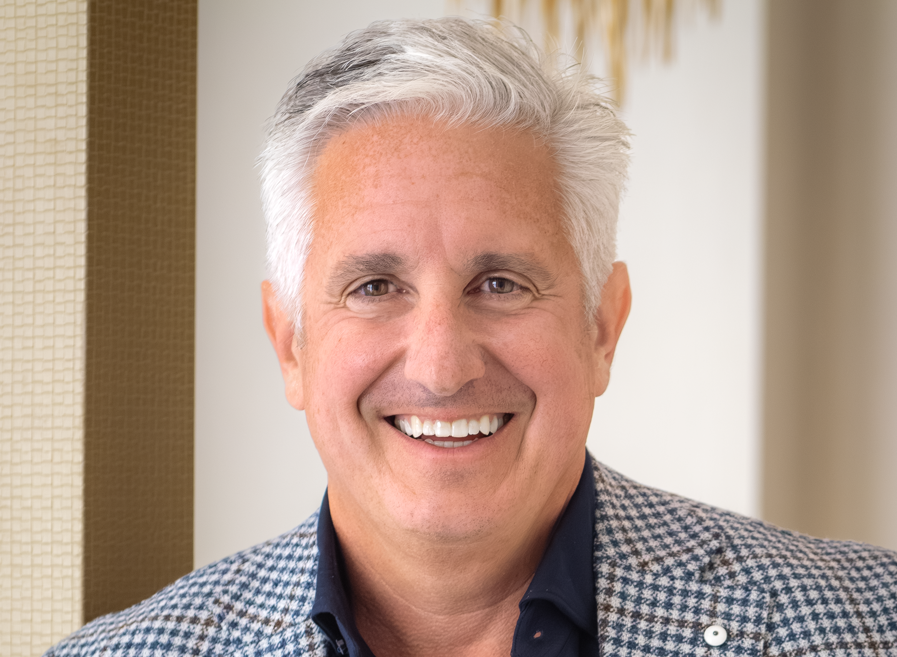
Questions?
Contact:
(optional headshot on right)
Name
Email:
Phone:
LinkedIn:
ADD YOUR HEADSHOT HERE

