Slide 1
Company
Overview
Property and Casualty
Benefits and Life
Wealth and Retirement
Helping companies and individuals address their most significant risk, workforce, wealth management and retirement challenges.

Slide 2
Company
Overview
Property and Casualty
Benefits and Life
Wealth and Retirement
Helping companies and individuals address their most significant risk, workforce, wealth management and retirement challenges.

Slide 3
Company
Overview
Property and Casualty
Benefits and Life
Wealth and Retirement
Helping companies and individuals address their most significant risk, workforce, wealth management and retirement challenges.

Slide 4
Who We Are
NFP, an Aon company, is an integrated organization of consultative advisors and problem solvers.
We provide expertise to help companies and individuals address their most significant risk, workforce, wealth management and retirement challenges.
The value we deliver is driven by the proactive collaboration, diverse perspectives and grounded ambition of more than 7,700 colleagues in the US, Puerto Rico, Canada, UK and Ireland.
Our Mission
Deliver global capabilities and solutions to a diversity of clients, industries and communities by putting people first, prioritizing partnerships, solving problems and continuously advancing a culture we’re proud of.
Our Core Tenets
Put People First
Size and Scale Matter
Prioritize Partnerships
Solve Problems with Expertise
Build Culture with Integrity

Slide 5
Where We Are
Industry (customize)
NFP is a global organization, headquartered in the US, with a growing
international presence.
Global
Reach
We have offices in the US, Puerto Rico, Canada and Europe
7,700+
employees

Slide 6
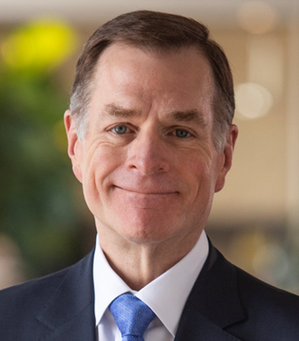
NFP, an Aon company
Aon completed its acquisition of NFP on April 25, 2024, making NFP an independent and connected platform within Aon.
We operate independently under the NFP brand
We have access to the breadth and depth of Aon’s diverse resources and global reach
Client accounts/coverages and points of contact remain unchanged
We have enhanced our ability to help clients address their most significant risk, workforce, wealth management and retirement challenges
Aon is a complementary partner that supports our commitment to:
Providing specialized expertise and insight that drive better outcomes for clients
Advancing a people-first culture focused on well-being, belonging and impact
Driving growth organically and through strategic acquisitions
Investing in communities consistent with our values
Using our collective scale to create opportunities for employees and clients that align with their goals
  “Together, NFP and Aon will help clients address increasing volatility across risk and people issues. With high-performing teams and leading content and capability, we are creating more value for our clients while also enhancing long-term shareholder value creation for investors.”
  Greg Case, CEO, Aon

Slide 7
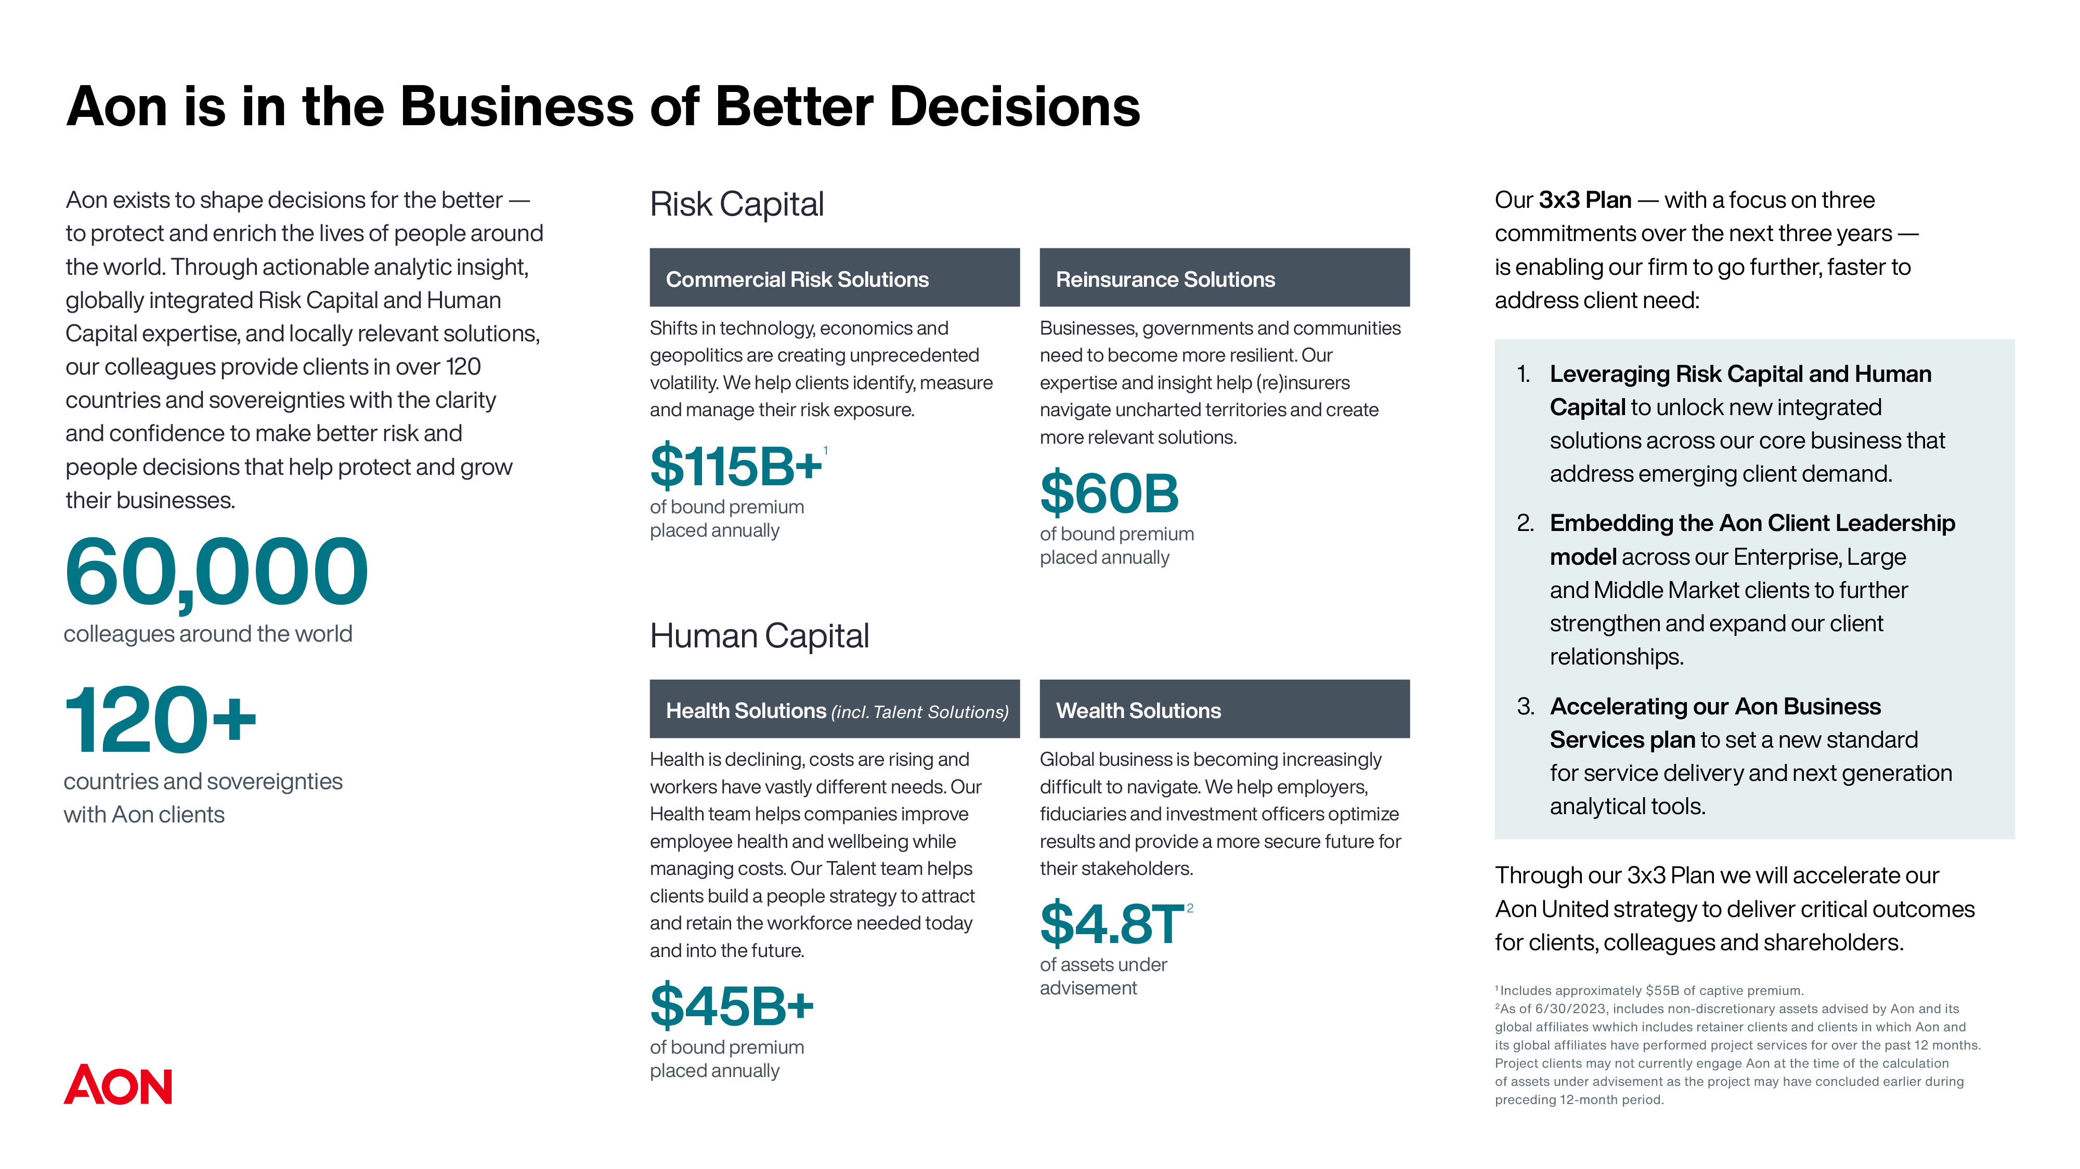

Slide 8
Numbers We’re Proud Of
Industry Recognition
Consistent revenue growth
2019: $1.46B
2020: $1.59B
2021: $1.91B
2022: $2.21B
2023: $2.50B
8th best place to work in insurance
Business Insurance
13th largest global insurance broker
Best’s Review
13th largest broker of US business
Business Insurance
7th largest benefits broker by global revenue
Business Insurance
9th largest property and casualty agency
Insurance Journal
8th commercial lines agency by P&C commercial lines revenue
Insurance Journal
Community Investment
11
13th personal lines agency, based on P&C and personal lines revenue
Business Insurance
organizations supported on a global or national level with money, time or other resources, including Disability:IN, National LGBT Chamber of Commerce, US Black Chambers, Wounded Warrior Project and more (with additional investment and engagement at the local level).
2nd largest DC retirement advisor
National Association of Plan Advisors

Slide 9
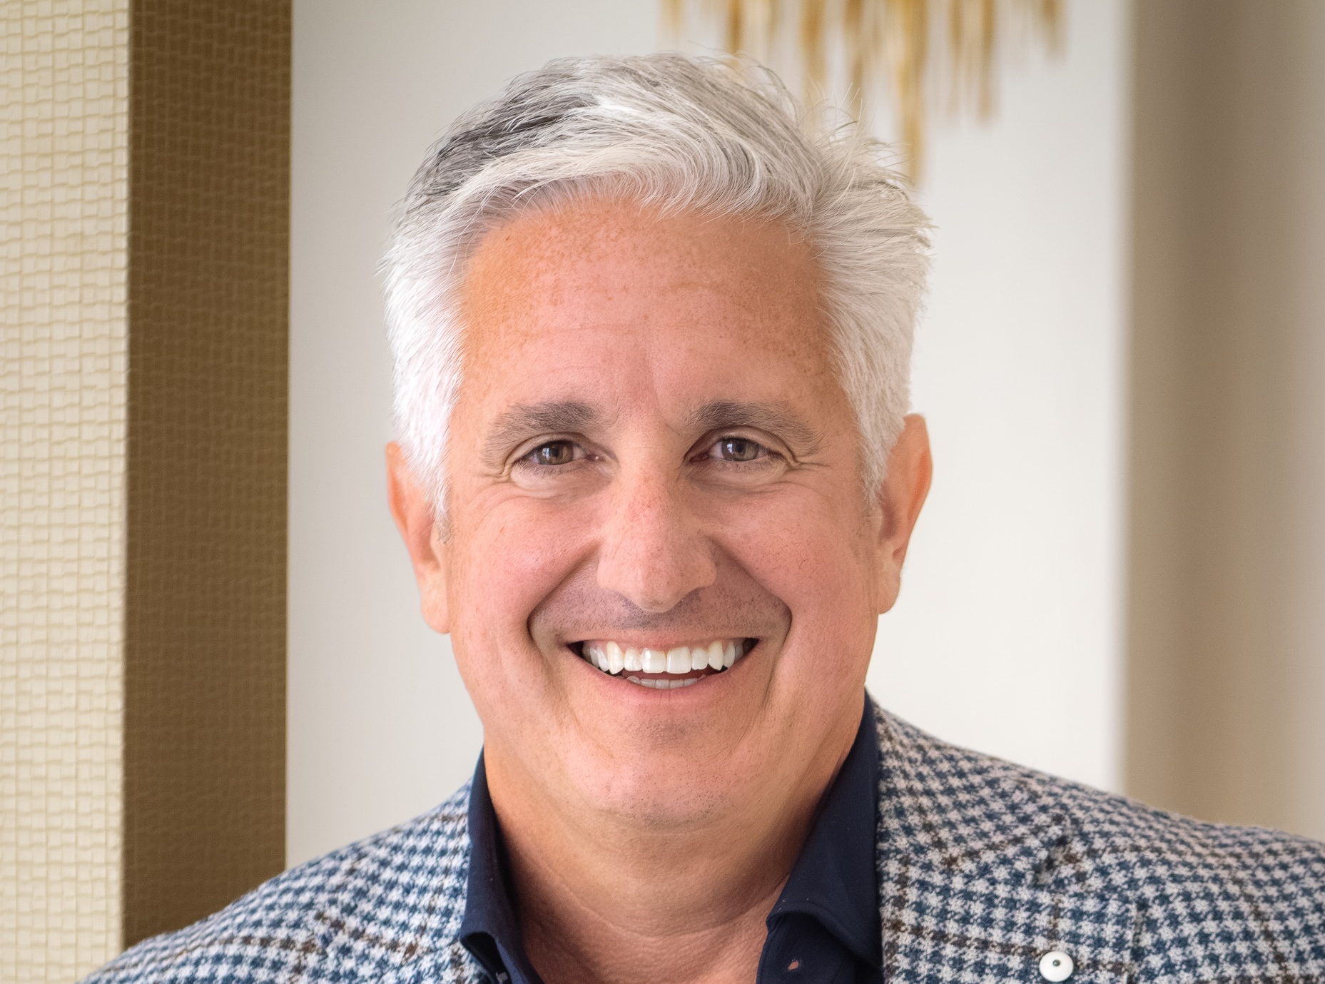
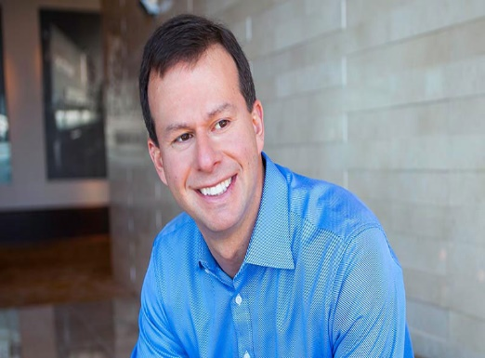
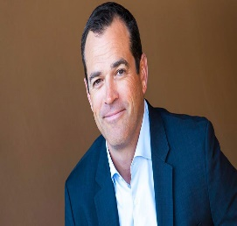
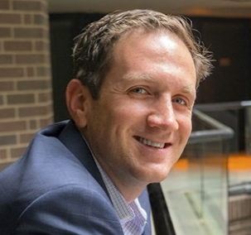
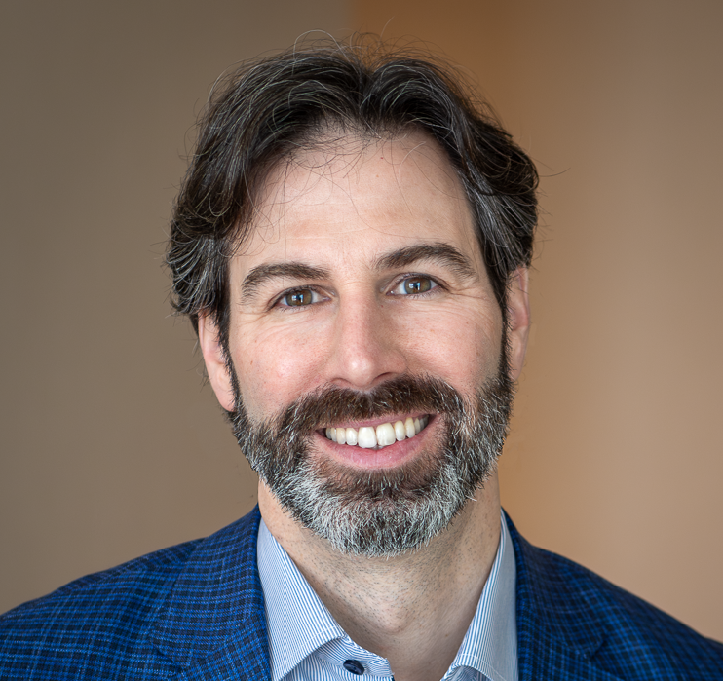
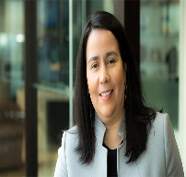

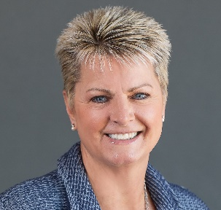
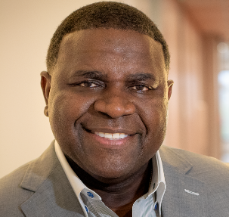



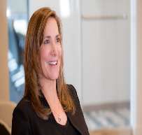
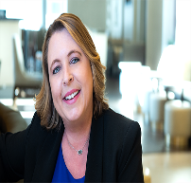
Leadership Structure
Doug Hammond
Chief Executive Officer
Mike Goldman
President and
Chief Operating Officer
We have a core executive team complemented by a collaborative regional leadership structure. This allows us to align decisions and initiatives with the needs
of our teams and our clients across regions.
Ed O’Malley
Executive Vice President, Head of Insurance Brokerage and Consulting
Evan Michael
Executive Vice President and General Counsel
Brett Schneider
Executive Vice President and Chief Financial Officer
Ginnette
Quesada-Kunkel
Executive Vice President and Chief Human Resources Officer
Carl Nelson
Executive Vice President, Mergers & Acquisitions
Kimberly Bell
Executive Vice President, Head of Health and Benefits
Mike James
Executive Vice President and Chief Sales Officer
Eric Boester
Executive Vice President and Chief Marketing Officer
Mark Grosvenor
Executive Vice President and Chief Technology Officer
Pamela Wheeler
Chief Diversity & Inclusion Officer
Suzanne Spradley
Chief Compliance Officer, Associate General Counsel
Mary Steed
Chief People Officer

Slide 10
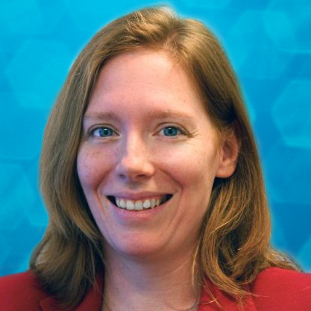
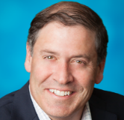
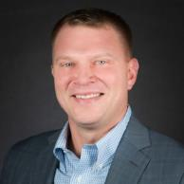
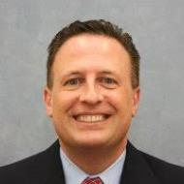
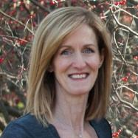
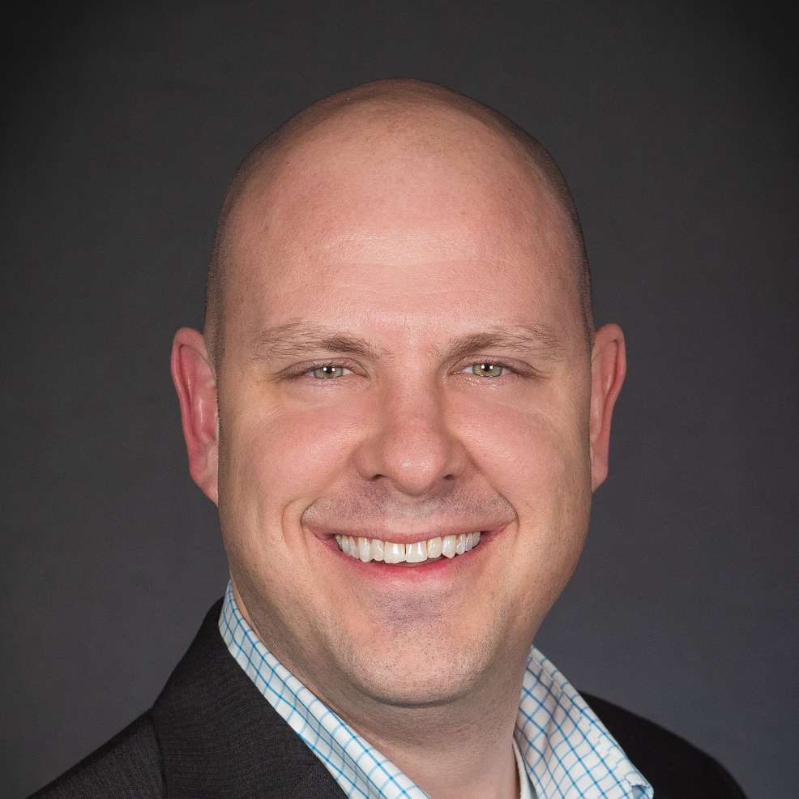
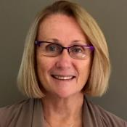
Your Local NFP Leaders
Organize photos and titles as necessary.
We have a core executive team complemented by a collaborative regional leadership structure. This allows us to align decisions and initiatives with the needs
of our teams and our clients across regions.
Kate Henry
Regional President
Benefits Leader
Mike Walsh
Regional President
P&C Leader
Chris Feneli
Regional Managing Director, NY Metro Market Leader
Paul Costantino
Regional Managing Director, Northeast P&C
Sue Donohue
Regional Managing Director, New England Market Leader
Daniel Rodliff
Senior Vice President of Sales, P&C
Sue Lodemore
Senior Vice President of Sales, Corporate Benefits

Slide 11
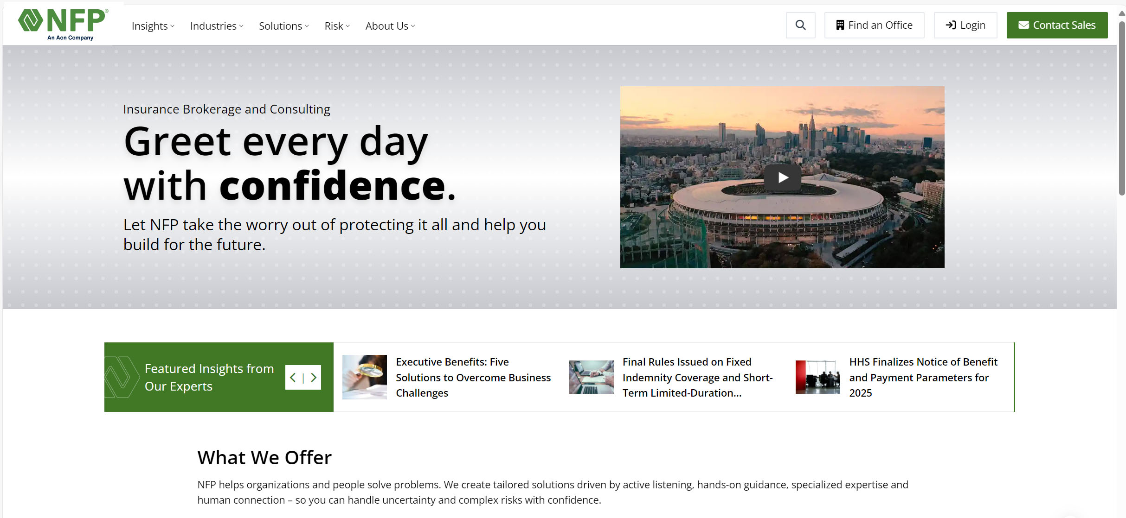
NFP.com
A Window Into Our Company
NFP.com is the best place to start finding solutions for your own and your business’s most significant risk, workforce, wealth management and retirement challenges.
Learn how we can help you plan for today and tomorrow. Explore the breadth and depth of our business, including the industries we serve. Our site also showcases our values and culture and provides an office locator so you can connect with an NFP expert.
We're constantly at work improving NFP.com so you can quickly and easily find answers and insights.

Slide 12

Client Communication and Thought Leadership
Partnerships are about collaboration, accountability and continuous improvement.
We build long-term connections, delivering thoughtful insights and strategies, supported by a commitment to exceptional service, to move forward together.
We strive to be our partners’ first call when they need something, regardless of whether it generates revenue, and we’re committed to building the goodwill that’s critical to deep, lasting bonds.
That's why we consistently deliver clear communications and ideas to you.
Insights on NFP.com
Frequent, focused webinars
Newsletters
Insights from the Experts podcast
1-on-1 emails, informative email campaigns
Industry conference presence

Slide 13
Our Commitment to Ethics
Through aligned collaboration, we continuously evolve, strengthen our ethical culture, and elevate awareness, safety and mutual respect.
We promote ethical behavior and an ethical culture.
We demonstrate our commitment to clients, partners, vendors and prospective employees.
We educate employees on ethical practices and resources
We highlight how we strive to do the right things the right way.
Prioritizing Ethical Leadership
Strive to do the right things — the right way — for our clients.
Promote ethical behavior by providing employees access to best practices and resources that align with our respect for those who place their trust in us.
Encourage open and constructive dialogue throughout our community.
Work to continuously demonstrate our belief that in everything we do, ethics matter most.
  Speaking up is also an important element of our ethical culture. NFP employees are encouraged to use the NFP EthicsPoint hotline (855.296.9085 or nfp.alertline.com) if they have something to report.
  Reports are confidential, taken seriously and investigated by the appropriate team member(s) for resolution.

Slide 14

Data Security Certified:
NFP’s SOC 2 Type II
Making Your Security a Priority
As our client, you can trust we’re handling your personal information with the highest level of protection. We value the security of both you and your employees.
SOC 2 is an independent security certification confirming a company is securely managing its clients’ data. This designation means NFP meets the standard guidelines for the Trust Services Criteria requirements of security as defined by the American Institute of CPAs.
Distilling Data Management Down to What Matters
SOC 2 criteria for data management is based on five principles:
Security
Availability
Processing integrity
Confidentiality
Privacy
NFP will continue working to keep a SOC 2 Type II certification, ensuring that as standards change, we keep our IT environment and your data as a client secure.

Slide 15
Focus and Expertise
Property and Casualty
Benefits and Life
Wealth and Retirement
Commercial Risk
Personal Risk
Specialty Risk
Programs
Employee Benefits
Executive Benefit Plans
Human Capital Solutions
Life Insurance
Wealth Management
Retirement Plan Advisory
Institutional Investment Consulting
Business Management Solutions
Innovation as well as Diversity, Equity, Inclusion and Belonging are integrated throughout our business.

Slide 16
Property and Casualty
EXPERTISE AND SOLUTIONS

Slide 17

Property and Casualty
Expertise and Focus
NFP’s client-centric approach supports long-term relationships focused on empowering clients to overcome their most significant risk management challenges.
NFP experts across industries, products and programs work closely with clients to understand their specific risk exposures, develop customized insurance solutions, and provide proactive insight and support to enhance outcomes.
Our resources and services help clients better understand and mitigate risk and comply with regulatory requirements.
We provide:
Specialized industry focus and product expertise
Proprietary data analytics and modeling tools
Strategic utilization of technology systems
Capital market access
Proven and consistent service model
Creative thinking

Slide 18

How We’re Different
Specialized expertise across industries and risk practices, informed by our deep understanding of clients’ specific goals and challenges
A boutique offering, supported by local service and insight, flexible access, customized solutions, and global resources, that aligns with client needs and drives an exceptional customer experience
Problem solving mindset that prioritizes listening and encourages creativity
Consultative approach that gets the right people in the room at the right time
Service agility, driven by empowerment and accountability, that enhances the client experience
Global capabilities to serve businesses and individuals no matter where they are
Collaborative, people-first culture focused on partnering with clients to enhance outcomes

Slide 19
National Practices
Industry Practices
Risk Practices
Construction and Infrastructure
Real Estate
Private Equity
Law Firms
Financial Institutions
Energy and Marine
Healthcare and Life Sciences
Sports and Entertainment
Management, Cyber, and Professional Liability
Complex Risk (Casualty, Property, Actuarial/ Modeling, Captives, Claims, Loss Control)
Surety (managed by C&I)
Environmental
Aviation
Multinational
Trade Credit
SBU

Slide 20

Industry Practices
Construction and Infrastructure
Owners
Contractors
Developers
Public Entities
Real Estate
Real Estate Owners
Property Managers
Real Estate Developers
Asset Managers
Private Equity
Core Property Casualty
Insurance Due Diligence
Restructuring & Insurance Optimization
Special Purpose Acquisition Company
General Partnership Liability
Transaction Advisory
Law Firms
Law Firms
Boutique Consultancies
Title Agencies
Other Misc. Professional Firms
Financial Institutions
Banks
Insurance Companies
Investment Managers
Energy and Marine
Oil & Gas Exploration and Extraction
Pipeline & Transportation
Refineries & Petrochem Manufacturing
Power Generation
Marine – Blue Water, Brown Water, Terminals / Ports, Cargo
Healthcare and Life Sciences
Biotech and Pharmaceuticals
Cannabis
Medical Device and Technology
Hospitals and Healthcare
Physicians and Medical Groups
Sports and Entertainment
Sports
Entertainment
Events and Touring

Slide 21
Totalis Program Underwriters
Totalis Program Underwriters is a scaled and integrated platform providing specialized expertise and solutions for niche and underserved areas of the market. With a growing collection of highly regarded specialty programs in multiple industries, we’re leveraging opportunities to enhance and innovate solutions for today’s most complex risks.
Auto Services
Group
High Mileage Warranties & Vehicle Service Contracts
Blue Sky
Risk
Healthcare &
Life Sciences
Commercial
Surety
Wide Variety of Bonds,
Including Distressed Credit
Entertainment
Risk (ER)
Bar, Adult Entertainment, Nightclub
EverGuard
Insurance Services
Restaurant, Bar & Tavern
Financial Institutions
Group (EPP)
Equity Protection
Healthcare Industry
Insurance Services (HIIS)
Medical Malpractice
Insurance Specialty
Group (ISG)
Residential Construction
International
Insurance Group (IIG)
Cross-border Auto & Personal Lines, Mexpro Auto
Outdoor Insurance
Group (OIG)
Outdoor Recreation & Hospitality
Pantheon
Risk D&O
Excess Directors & Officers
Park Shield (PS)
Manufactured Housing Communities & RV Parks
Pro Financial
Services (PFS)
Sports & Entertainment,
Business and Medicine
ProTek
Medical Device Manufacturers
and Distributors
QuadScore D&O
Cannabis Directors & Officers
QuadScore (QS)
Cannabis
Quantum Risk
Solutions (QRS)
Transportation
Specialty Program Solutions (SPS)
Forestry & Construction

Slide 22
National Client Offerings
Services
Claims Management
Analytics
Actuarial
Captives and alternative risk
Complex risk
Occupational health and safety
International placement
Reinsurance
Claims support
Coverage analysis
Litigation management
Claims advocacy
Reserve and settlement evaluation
Claim reviews
Best-in-class technology
Benchmarking
Advanced catastrophe modeling
Private data lake
AI-supported data enrichment
Customized and dynamic
claims data
Secure and private
document exchange
Real-time digital asset access

Slide 23
NFP Client Service Model
Prepare
Gather • Analyze • Develop
Perform
Evaluate • Service • Collaborate
NFP’s client service model is supported by a commitment to identifying and understanding each client’s unique risk factors.
Through interviews with key individuals, site inspections, document analysis and market assessments, we invest resources in knowing our clients.
This translates into a customized strategy with services and solutions that align with the client’s specific risks, goals and challenges.
NFP Placement Process
Promote
Negotiate • Compare • Recommend
Place
Execute • Review • Deliver

Slide 24
Benefits and Life
EXPERTISE AND SOLUTIONS

Slide 25

Benefits Value Proposition
Our Benefits teams combine the experience, savvy and scale of an established company with the innovation and flexibility of a startup.
We are a team of passionate and seasoned professionals dedicated to supporting each other and our clients.
We deliver the expertise, solutions and service that employers – of all sizes and across industries – need to attract and retain talent, support the diverse needs of employees and their families, and thrive.
Employee benefits
Executive benefits plans
Human capital solutions

Slide 26

Our Employee Benefits Solutions
With a holistic, consultative approach to employee benefits, we start by assessing an employer’s unique goals and objectives, along with the expectations of their employees, and continue with the development and execution of a customized strategy designed to meet those specific needs.
Whether it’s a one-year or multi-year strategy, we’re there for our clients every step of the way with the breadth of solutions, depth of knowledge and excellence in execution that enhance outcomes.
Solutions and expertise include:
Employee benefits consulting
Benefits compliance
Benefits and HR technology
Centers of Excellence:
  Pharmacy management
  Stop loss
  PEO
  Ancillary benefits
Well-being and engagement
Captive and alternative risk
Employee communications
International benefits
Long-term care
Actuarial and financial analysis
Benchmarking and trend analysis

Slide 27
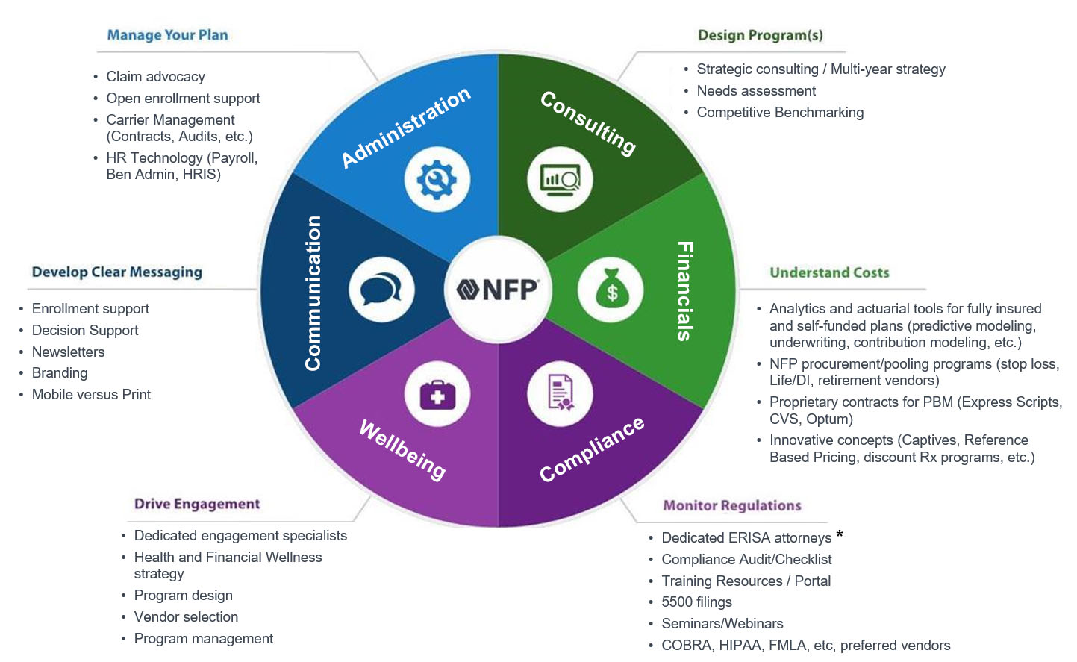
An Integrated Approach to Client Care
*NFP does not provide legal advice.

Slide 28

Human Capital Solutions —
A Valuable Partnership
For companies that don’t have the time, interest, energy or resources to manage a comprehensive human resources infrastructure, our HR experts are there to step forward. We serve as a trusted partner to a leadership team, allowing them to focus on running and growing their business.
We take time to understand obstacles and objectives, and deploy expertise to maximize the impact of a company’s HR function across their organization.
Whether you want to improve employee engagement and performance, retain top talent or increase efficiency in your organization, we can assist you with thorough policy and program evaluation, compensation benchmarking, and other solutions and support. We have the horsepower to get you where you want to be. Our capabilities include:
Strategic HR
Recruiting
Compensation and
total rewards
HR operations
HR technology
People development
International HR
Career transition and
out-placement

Slide 29
Core Benefits and Insurance Specialties
Our specialists hold particular expertise in the arenas of:
NFP is focused on every aspect of your benefits and insurance needs, but we do have specific experts focused on pushing boundaries and providing excellent service for:
  Well-being and engagement
  Pharmacy management
  Voluntary benefits
  Cost containment strategies
  Captives and alternative risk
  Benefits compliance
Well-Being and Engagement
  Transform your wellness approach
  to a well-being strategy.
  Empower your organization to sustain a healthier mental, emotional, financial and physical state for employees.
  Develop an engaging well-being strategy that aligns with your goals, promotes employee participation and delivers results.
Pharmacy Management
  High-cost drug management through Rx Solutions
    NFP Rx Solutions is a leading pharmacy benefits consulting firm providing experienced account management, clinical services, AI and plan oversight.
  Voluntary Benefits
  Mitigate financial uncertainty, ease stress and offer better quality of life support with options to help your employees.
    Fill gaps in coverage (deductibles, coinsurance, copay and out-of-pocket expenses)
    Provide greater financial security.
    Elevate value by helping deliver more comprehensive coverage for half the cost of a daily coffee.

Slide 30
Core Benefits and Insurance Specialties
Our specialists hold particular expertise in the arenas of:
Cost Containment Strategies
  Integrate your approach to client care with advanced cost containment strategies that support successful benefits solutions.
    Program design, regulation monitoring, plan management and overall engagement can make a difference.
    Single and multi-year strategies to meet your organization’s needs.
    Ongoing development and execution of customized, holistic support.
Captives and Alternative Risk
  Our CaptivePlus group medical stop loss captive is a risk management solution for employers seeking an alternative to the current market.
  Benefit from the transparency and control of self‐funding, combined with the stability and scale of a group captive, for a true opportunity to manage health plan risk.
Benefits Compliance
  Helping you navigate legislative changes through our:
    Compliance team of in-house attorneys well versed in ACA, COBRA, FMLA.
    Research team decoding the latest benefits compliance trends.
    Compliance audits to help you adhere to plan rules.
    Educational resources including our Compliance Corner newsletter on new legislation, and seminars clarifying complex topics.
NFP is focused on every aspect of your benefits and insurance needs, but we do have specific experts focused on pushing boundaries and providing excellent service for:
  Well-being and engagement
  Pharmacy management
  Voluntary benefits
  Cost containment strategies
  Captives and alternative risk
  Benefits compliance

Slide 31
Executive Benefits Leadership
Our comprehensive expertise and solutions include:
NFP designs, implements and administers executive benefits programs that help companies offer key executives long-term financial stability.
The advantage of attracting, retaining and rewarding top talent through their working career helps prevent turnover costs, increases employee satisfaction and, ultimately, enables loyal, quality people to contribute to the future of their own retirement and the growth of a business.
Our focus is always on
what will yield the best
results for each client and their executives.
Executive Retirement
  Deferred compensation
  Supplemental executive retirement plans (SERPs)
Executive Life Insurance
  Executive bonus plans
  Split-dollar life insurance
  Death-benefit-only plans
Institutional Funding Solutions
  Bank-owned life insurance (BOLI)
  Corporate-owned life insurance (COLI)
  Insurance company-owned life insurance (ICOLI)
Global Benefits
  Executive plans
  Carried interest plans
Corporate Sponsored
Disability Protection
  Executive disability
  Executive long-term care
  Life insurance
Compensation Consulting
  Executive, employee and board of directors compensation
Plan Administration
  BOLI
  Nonqualified deferred compensation (NQDC)
  Global executive plans

Slide 32
Life Insurance Differentiators
Life Insurance
Estate Planning
Wealth transfer
Charitable planning
Estate equalization
Premium financing
Multigenerational planning
Asset protection
Permanent and term products
Select direct carrier access
Carrier and product intelligence
Underwriting advocacy and negotiation
Large case strategy
Jumbo-limit cases
Special risk underwriting
Proprietary business technology
operating platform
Annuities
Traditional fixed
Fixed indexed
Tax deferral
Single premium immediate annuity (SPIA)
Equity exposure without equity risk
Safety/protection of principal
Probate avoidance
Guaranteed income planning
Tax-efficient income distribution
Guaranteed liquidity features
Optional product riders
Long-Term Care Planning
Custom LTC planning
Traditional LTC insurance
Linked benefit and hybrid/LTC insurance
Annuity/LTC insurance
Executive LTC programs
Concierge application fulfillment
Association solutions
Disability
Individual disability insurance
Multi-life disability insurance
High-limit disability insurance
Impaired/substandard disability insurance

Slide 33
Wealth and Retirement
EXPERTISE AND SOLUTIONS

Slide 34

Wealth and Retirement
Value Proposition
  We help individuals and families preserve, protect and grow their assets, as well as
  fund their personal, professional and philanthropic goals.
  Our expertise, market access, industry alliances and buying power are coordinated and delivered through our wealth management and retirement platforms.

Slide 35



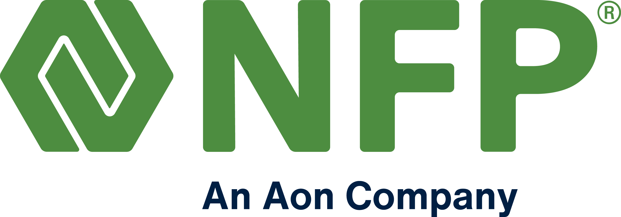

Wealth Management Excellence
Asset management
Cash flow planning
Advisor collaboration (attorney, CPA, etc.)
Trust and estate planning
Total insurance solutions
Multiple scenario illustrations and analysis
Banking solutions
Family office services
NFP’s wealth management expertise is also accessible through these industry-leading NFP companies:
$50B
Assets Under Management*
* As of December 31, 2023, Source: NFP.

Slide 36

Holistic Business Management Capabilities
These services, which complement NFP's individually focused businesses, include:
Cash flow management, budgeting and expense projection
Financial recordkeeping
Managing and monitoring check receipts and bill payments
Risk management, including support acquiring appropriate insurance coverage
Strategic tax, estate and debt planning
Structuring of business and charitable entities
Negotiation of real estate and major asset acquisitions (watercraft, art, aircraft, etc.)
Continuous review of investments coordinated with financial institutions and advisors
Ground Control Business Management, an NFP company, offers holistic business management services to high net worth clients, including entertainment industry executives, entertainers and professional athletes.

Slide 37

A Retirement
Powerhouse
NFP is one of the largest qualified retirement plan advisers in the US, providing consulting services and overseeing nearly $400 billion* in retirement plan assets.
$400B
plan assets
Our team focuses solely on areas that drive
retirement plan success:
Investment analysis
Fee benchmarking and
negotiations
Fiduciary compliance
Plan design
Participant education and financial wellness
Target date fund consulting
* As of December 31, 2023, Figure includes NFP's retirement businesses, including Fiducient. Source: NFP.

Slide 38


WellCents
WellCents is an end-to-end financial advice solution designed to help you achieve assurance in your financial life.
The goal is to help you develop a real-life action plan to move you toward being financially well, and in turn, help you secure a financially sound retirement.
WellCents services are complimentary
to all team members.
Wellness assessment
Meetings and workshops
Resources and action plan

Slide 39


WellCentsPLUS
WellCentsPLUS is a comprehensive white glove financial planning service designed specifically for executives with complex financial lives.
Powered by Wealthspire Advisors, an NFP company, WellCentsPLUS is like having a personal CFO to help manage all aspects of your financial life and integrate them into a customized plan.
WellCentsPLUS helps you achieve holistic financial planning and access timely advice on important planning topics through a secure, intuitive platform.

Slide 40
Innovation

Slide 41

A “What If” Approach to
Innovation
For NFP, innovation is about ideation that connects problems with solutions and positively impacts people.
Our approach is collaborative, inclusive and purpose driven.
While many people equate innovation solely to technology, true innovation is about creating value – by solving problems, enhancing convenience, reducing cost – in our everyday lives.​
​We deliver value to our clients by:
Reimagining the way we conduct business and interact with each other, our partners and our clients so we
can be more successful together​
Engaging with employers to better understand their challenges and
pain points
Reinforcing our growth-focused culture by continuously improving structures for inclusively supporting our employees and their efforts​
Scouting and vetting new ideas and solutions in insurtech, fintech, HRtech and healthtech ​to keep ahead of market trends and provide thought leadership to ​our industry​

Slide 42
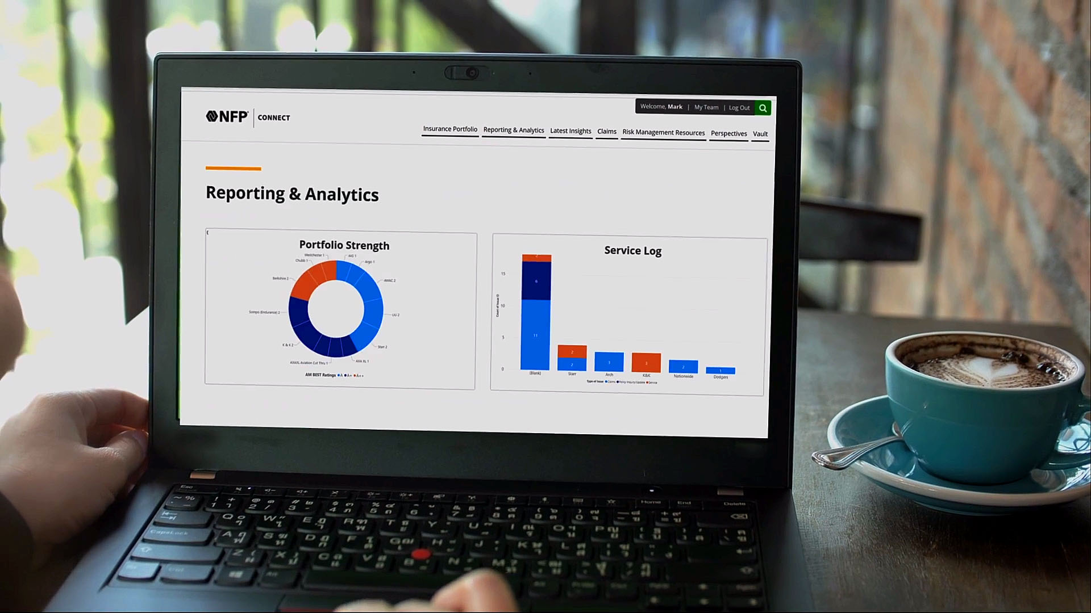
Digital Transformation with NFP Connect
Technology advancements, the rise of the Internet of Things and an influx of new solutions have made it easier than ever to use data to inform decisions and help mitigate risk.
Challenges:
Navigating the market and disparate solutions, capitalizing on the data capture and maintaining a unified user experience.
Solution:
NFP Connect, an integrated digital platform that combines frictionless access to best-in-class technology within an enterprise-wide data aggregation framework.
Unlock the power of your data, across corporate benefits, retirement and P&C.
Access a private data lake and AI-supported data enrichment.
Create customized and dynamic data visualization.
Exchange documents securely and privately.
Deliver content digitally.
Provide mobile-first employee-level access.
Accessible 24/7/365.

Slide 43
Diversity | Equity | Inclusion | Belonging
(DEIB)

Slide 44

The Power of DEIB
We want to be proud of the company we’re part of, so no matter how fast paced our environment is, doing things the right way is essential.
We’re all part of the same dynamic team, winning, learning and making an impact together, while appreciating the opportunities to collaborate on shared objectives.
Our diversity, equity, inclusion and belonging programs and practices are designed to support our employees, clients, supplier partners and the communities where we live and work.​
Collaborating
Helping
Driving

Slide 45


Active Participation at
Every Level
The DEIB Advisory Board is the driving force behind our efforts to advance DEIB. With voices and perspectives from a cross-functional, cross-level representation of employees, this group elevates an environment where all employees feel welcomed, encouraged and valued.
Our regional action committees consistently deliver materials and resources to support employee learning and growth on a regional level, collaborating with business resource groups to cultivate engagement and implementation.
Business resource groups are employee-driven, serving as forums for advancement, alignment collaboration and belonging.
Led by example. Our DEIB principles are implemented at the C-Suite level. Executives participate in the Lean In and McKinsey & Company “Women in the Workplace” study, and we work with Paradigm for Parity to keep moving toward a more equitable future.
Current Business Resource Groups:
Asian
Black Professionals​
D-IS-Ability
Indigenous People
Family
Latine
Military/Veterans
PRIDE+
Women’s

Slide 46
Cultivating DEIB in Community
We are committed to providing support for organizations with a vision for achieving critical DEIB progress in our industry and our communities.
Industry
National and Global
Regional
Financial Alliance for Racial Equity (FARE)
LINK Canada (LGBTQ+ Insurance Network)
Black Insurance Industry Collective (BIIC)
National African American Insurance Association (NAAIA)
Canadian Association of Black Insurance Professionals (CABIP)
The American College of Financial Services
The American College’s Center for Economic Empowerment and Equality
Wounded Warrior Project (WWP)
National Minority Supplier Development Council
US Black Chambers
CEO Commission for Disability Employment
GenHERation
Year Up
Diversity Woman Media
National Association of Asian American Professionals (NAAAP)
National Minority Supplier Development Council (MNSDC)
Women’s Business Enterprise National Council (WBENC)
National LGBT Chamber of Commerce (NGLCC)
Disability:IN
100 Black Men of Austin (a chapter of 100 Black Men of America)
Texas Empowerment Academy
Advisors Give Back
Indspire
Junior Achievement
Envision

Slide 47


Questions?
Contact:
(optional headshot on right)
Name
Email:
Phone:
LinkedIn:

