Slide 1
Welcome to NFP
Presenter

Slide 3
Title

Slide 4
Title

Slide 5
Title

Slide 6
Title

Slide 8
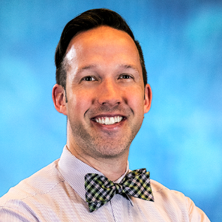
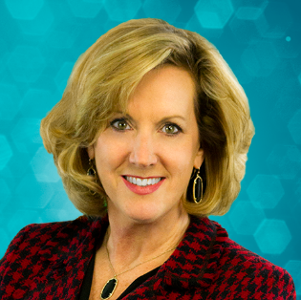
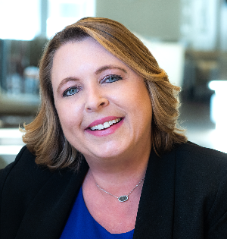
Presenters
Christopher Magott
NFP
Sr. Talent Development Specialist
Robin Johnston
NFP
SVP, Business Development
Mary Steed
NFP
SVP, Chief People Officer

Slide 9
Course Objectives
Learn about our:
Structure, office locations and leadership
Revenue growth, business strategy and service offerings
PeopleFirst culture and programs
Pay Attention!
Quiz at the end for a chance to win some cool NFP swag!

Slide 10
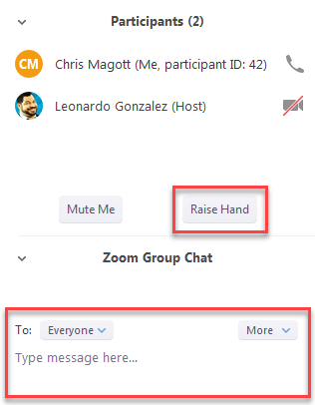
Zoom Tools and How to Use Them
Communication Tools (Mute/Unmute, Participants, Chat)
Mute/Unmute = use this button (not your phone) to control your phone line
Participants = use the “Raise Hand” button to let us know you want to speak
Chat = use to message the host or other participants

Slide 11
National P&C Specialty Groups and Programs
Construction
• Corporate P&C • Project Specific P&C
• Commercial Surety • Contract Surety
• Residential Construction
Real Estate
• Real Estate Owners • Property Managers
• Real Estate Developers
Financial Institutions
• Corporate P&C • Lenders Singe Interest
• Equity Protection Program • Mortgage Insurance
Sports & Entertainment
• Sports • Entertainment • High Limit Disability
Captive & Alternative Risk
Cyber Liability
Environmental Liability
Management & Professional Liability
Reinsurance
Risk Management & Complex Risk
Trade Credit
Healthcare & Life Sciences
• Biotech and Pharmaceuticals • Device and Technology Distributors • Hospitals and Healthcare
• Physicians and Medical Professionals
Transportation
• Aviation • Auto Services
• Trucking
Hospitality & Leisure
• Outdoor Recreation • Cross-Border
• Restaurants, Bars and Taverns
Personal Risk
• Private Client Group • Affinity Groups
• Family Offices
Merger & Acquisition Risk Solutions
• Transaction Advisory • Core Property Casualty
• Restructuring & Insurance Optimization
• Special Purpose Acquisition Company
Complex Risk Solutions
• Forestry • Oil and Gas
• Mining • Renewable Energy

